Slide 1
Agent-Based Gathering Simulations
Roy Levi Sagiv Tamir

Slide 2
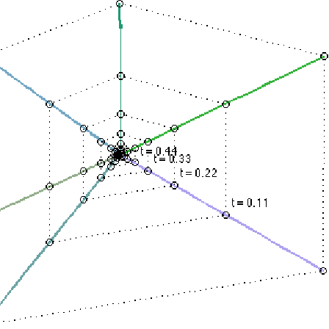
The Goal of Gathering
The goal of gathering is for many identical mobile agents to come together to perform tasks as a cohesive group using only their sensors to detect the relative locations of others in their vicinity.

Slide 3
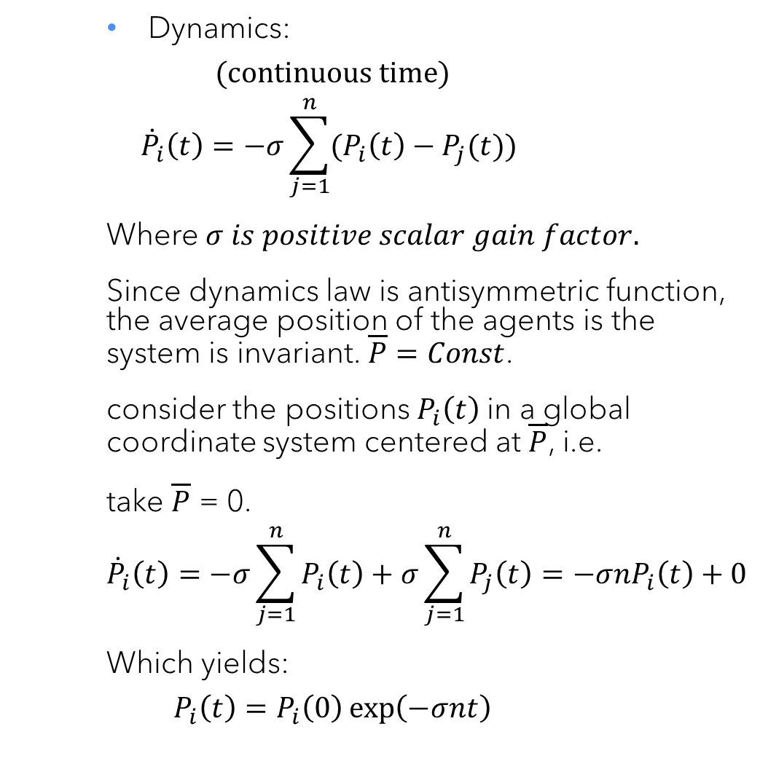
Unlimited Visibility, Position Sensing
Dynamics:
$$(continuous time)$$
$${\dot{P}}_{i}\left(t\right)=−σ\sum_{j=1}^{n}{(P_{i}\left(t\right)−P_{j}(t)})$$
Where $σ is positive scalar gain factor.$
Since dynamics law is antisymmetric function, the average position of the agents is the system is invariant. $\overline{P}=Const$.
consider the positions $P_{i}\left(t\right)$in a global coordinate system centered at $\overline{P}$, i.e.
take $\overline{P}$ = 0.
$${\dot{P}}_{i}\left(t\right)=−σ\sum_{j=1}^{n}{P_{i}\left(t\right)+σ\sum_{j=1}^{n}{P_{j}\left(t\right)}=−σnP_{i}\left(t\right)+0}$$
Which yields:
$$P_{i}\left(t\right)=P_{i}\left(0\right)\exp\left(−σnt\right)$$

Slide 4
From agent perspective
Each Agent:
While (True):
Broadcast my location to other agents.
Receive the locations of all other agents.
Calculate the new step.
Move.
The memory required includes n cells for (x,y) positions.
Memory is also needed to send and receive messages.

Slide 5
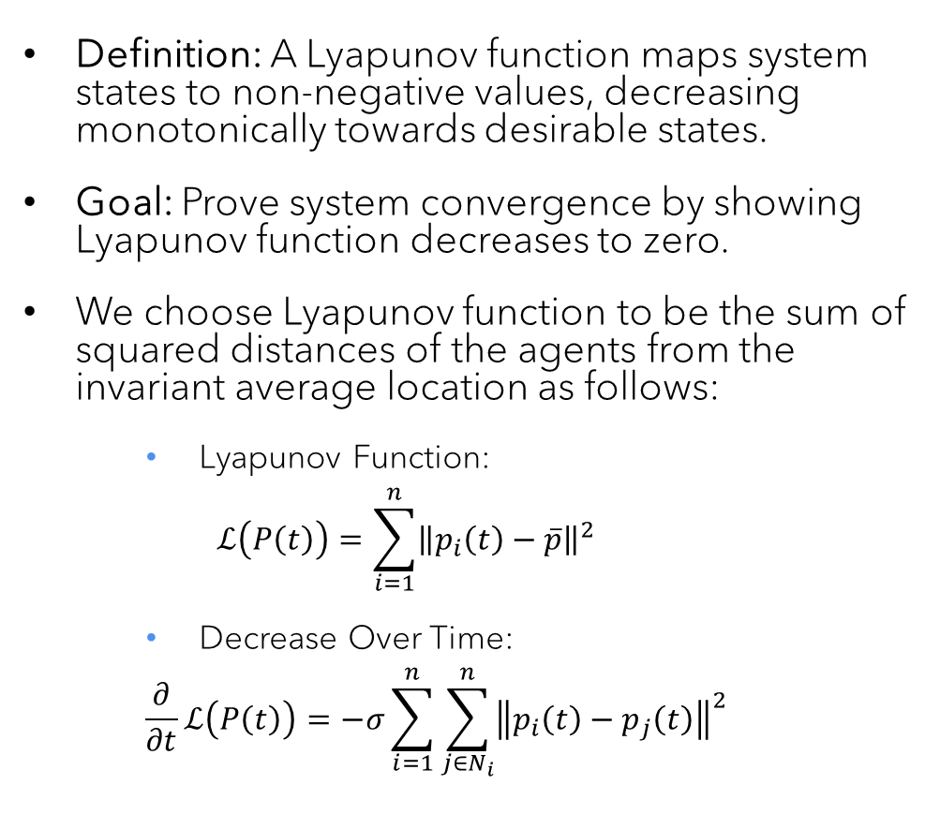
Convergence Analysis with Lyapunov Functions
Definition: A Lyapunov function maps system states to non-negative values, decreasing monotonically towards desirable states.
Goal: Prove system convergence by showing Lyapunov function decreases to zero.
We choose Lyapunov function to be the sum of squared distances of the agents from the invariant average location as follows:
Lyapunov Function:
$$ℒ\left(P\left(t\right)\right)=\sum_{i=1}^{n}{{\left\|p_{i}\left(t\right)−\overline{p}\right\|}^{2}}$$
Decrease Over Time:
$$\frac{∂}{∂t}ℒ\left(P\left(t\right)\right)=−σ\sum_{i=1}^{n}{\sum_{j∈N_{i}}^{n}{{\left\|p_{i}\left(t\right)−p_{j}\left(t\right)\right\|}^{2}}}$$

Slide 6
DEMO
YAY!

Slide 7
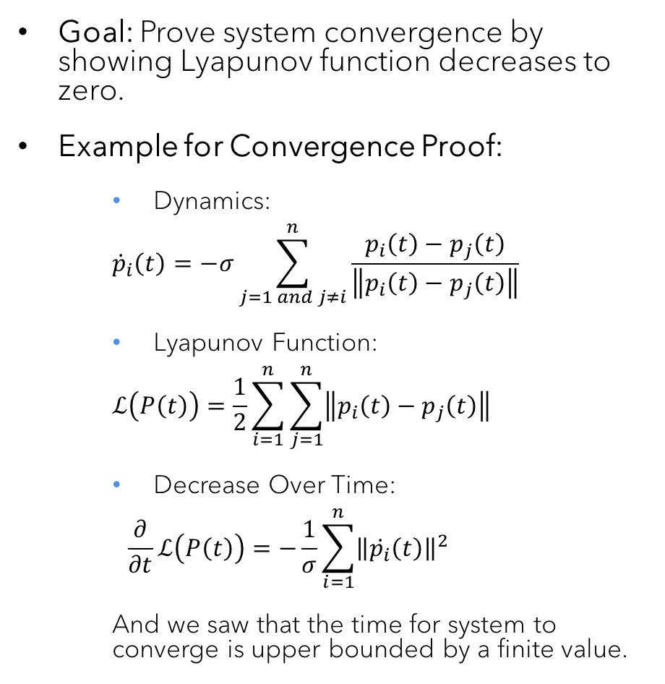
Unlimited Visibility, Bearing-only Sensing
Goal: Prove system convergence by showing Lyapunov function decreases to zero.
Example for Convergence Proof:
Dynamics:
$${\dot{p}}_{i}\left(t\right)=−σ\sum_{j=1 and j≠i}^{n}{\frac{p_{i}\left(t\right)−p_{j}\left(t\right)}{\left\|p_{i}\left(t\right)−p_{j}\left(t\right)\right\|}}$$
Lyapunov Function:
$$ℒ\left(P\left(t\right)\right)=\frac{1}{2}\sum_{i=1}^{n}{\sum_{j=1}^{n}{\left\|p_{i}\left(t\right)−p_{j}\left(t\right)\right\|}}$$
Decrease Over Time:
$$\frac{∂}{∂t}ℒ\left(P\left(t\right)\right)=−\frac{1}{σ}\sum_{i=1}^{n}{{\left\|\dot{p_{i}}\left(t\right)\right\|}^{2}}$$
And we saw that the time for system to converge is upper bounded by a finite value.

Slide 8
agents' trajectories Bearing-only vs Position Sensing

Slide 9
Collision Avoidance Mechanisms
Efficient Collision Avoidance in Multi-Agent Systems

Slide 10
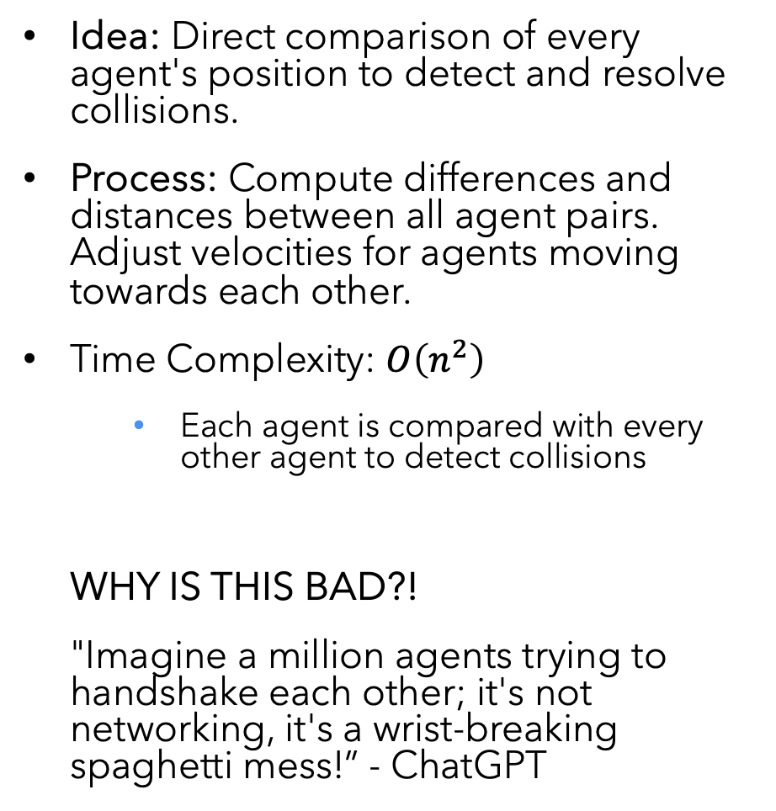
Naive Collision Adjustment
Idea: Direct comparison of every agent's position to detect and resolve collisions.
Process: Compute differences and distances between all agent pairs. Adjust velocities for agents moving towards each other.
Time Complexity: $O\left(n^{2}\right)$
Each agent is compared with every other agent to detect collisions
WHY IS THIS BAD?!
"Imagine a million agents trying to handshake each other; it's not networking, it's a wrist-breaking spaghetti mess!” - ChatGPT

Slide 11
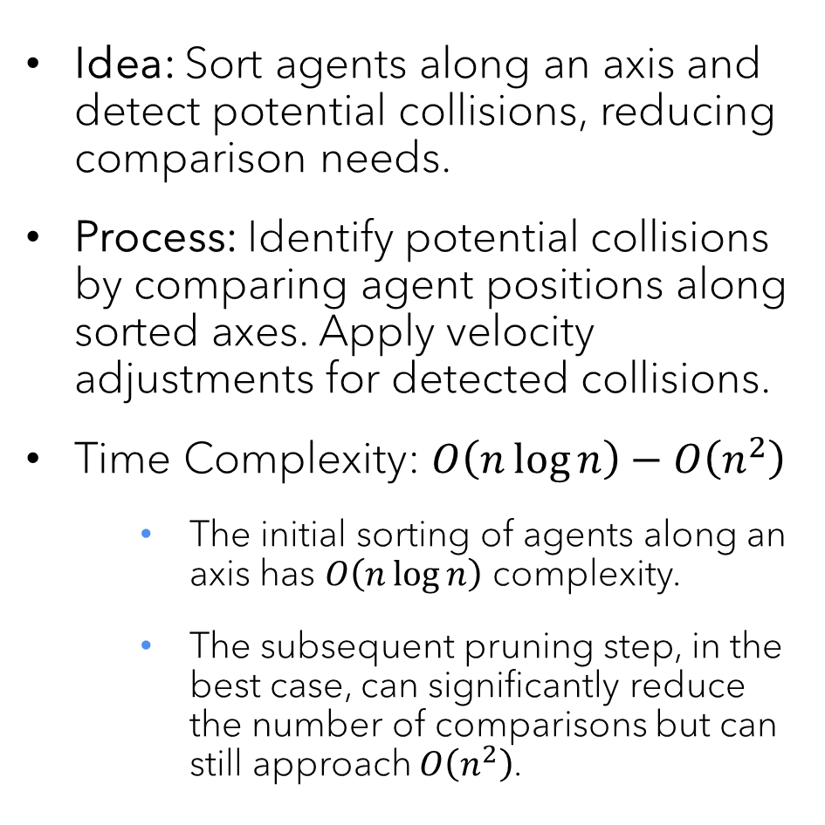
Sweep and Prune Method
Idea: Sort agents along an axis and detect potential collisions, reducing comparison needs.
Process: Identify potential collisions by comparing agent positions along sorted axes. Apply velocity adjustments for detected collisions.
Time Complexity: $O\left(n\log{n}\right)−O\left(n^{2}\right)$
The initial sorting of agents along an axis has $O\left(n\log{n}\right)$ complexity.
The subsequent pruning step, in the best case, can significantly reduce the number of comparisons but can still approach $O\left(n^{2}\right)$.

Slide 12
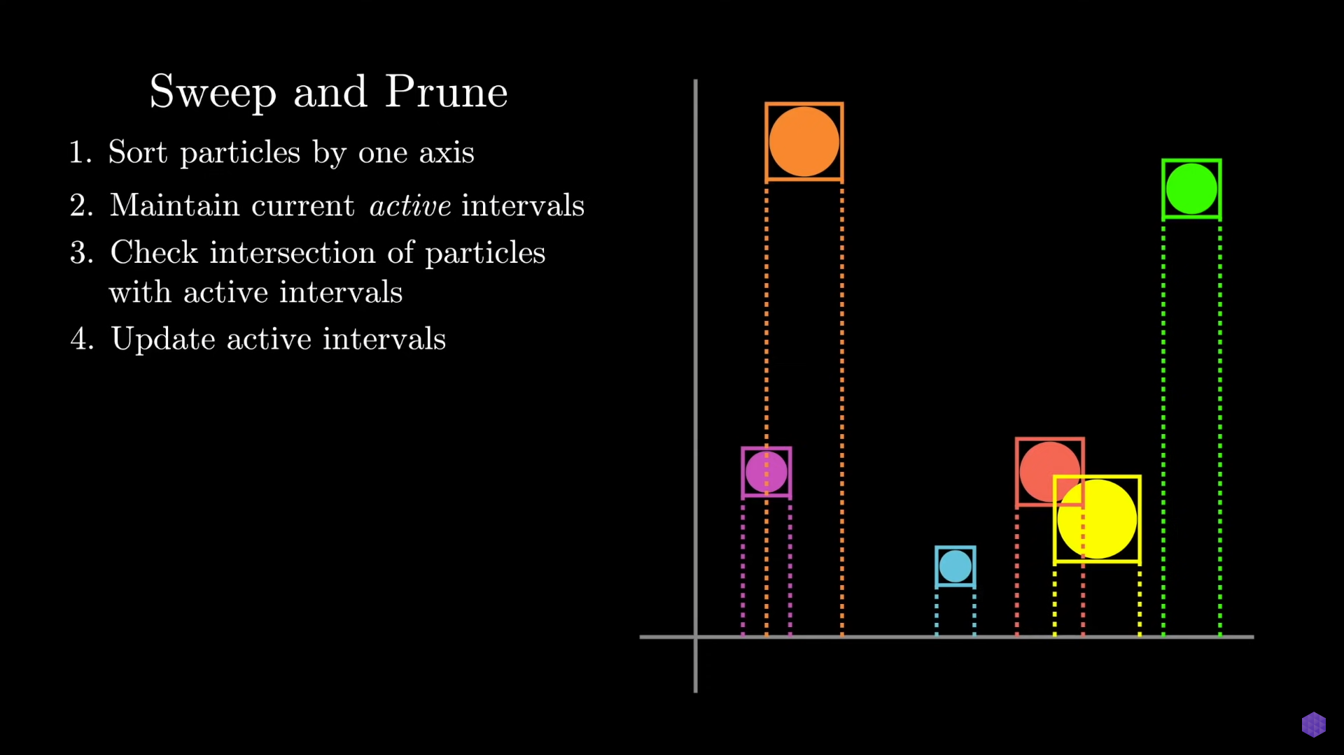

Slide 13
DEMO
YAY!

Slide 14
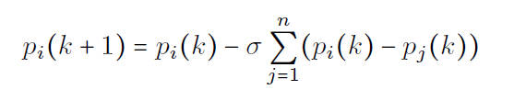
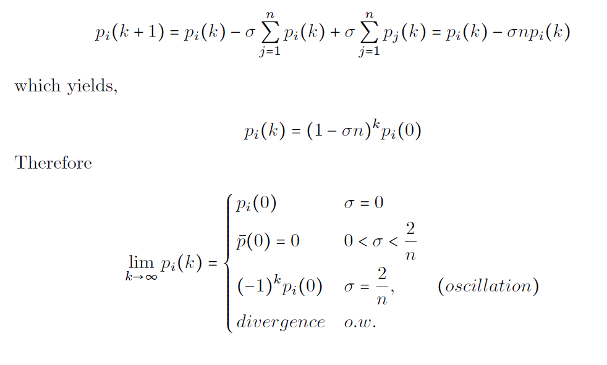

Scalability of time-discrete system Position sensing
Dynamics law:
$$σ is a function of n$$

Slide 15
DEMO
YAY!

Slide 16
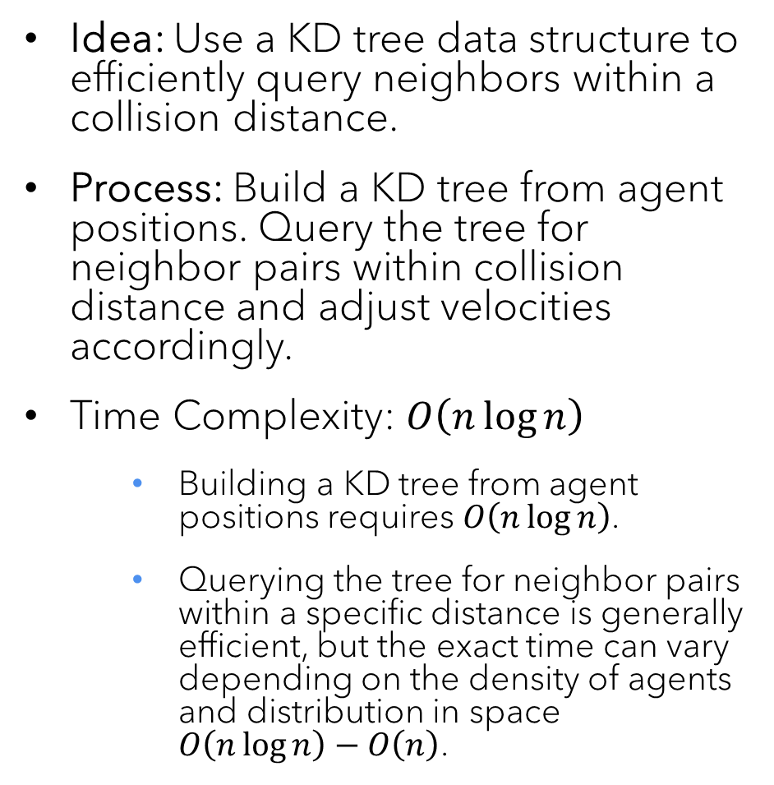
KD-Tree Based Adjustment
Idea: Use a KD tree data structure to efficiently query neighbors within a collision distance.
Process: Build a KD tree from agent positions. Query the tree for neighbor pairs within collision distance and adjust velocities accordingly.
Time Complexity: $O\left(n\log{n}\right)$
Building a KD tree from agent positions requires $O\left(n\log{n}\right)$.
Querying the tree for neighbor pairs within a specific distance is generally efficient, but the exact time can vary depending on the density of agents and distribution in space $O\left(n\log{n}\right)−O\left(n\right)$.

Slide 17
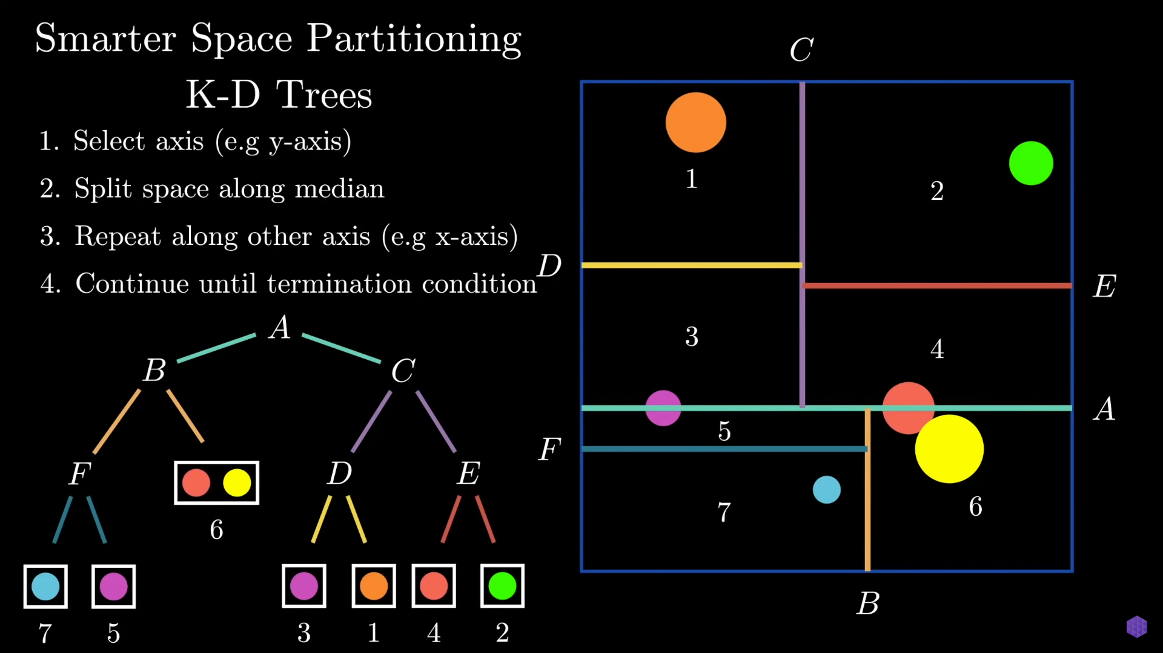

Slide 18
DEMO
YAY!

